Slide 1
Intelligent Log Analytics & Incident Prediction System
GUIDED BY:- Prof. Divya Das
GROUP MEMBERS:-
  1. Sukhada Pawar
  2. Neelu Meena
  3. Ishan Nayal

Slide 2

Abstract / Project Overview
• Modern IT systems generate massive volumes of log data
• Manual log analysis is inefficient and error-prone
• This project provides automated log analytics and incident prediction
•Combine Big Data technologies like HDFS, Hive, and PySpark with Machine Learning models to efficiently process logs and predict incidents before they escalate, thereby improving system reliability.

Slide 3

Problem Statement
• Log data is high-volume and semi-structured
• Traditional monitoring is reactive in nature
• Delayed incident detection leads to downtime
• Existing tools lack scalability and automation

Slide 4

Objectives
• Efficient storage and querying of log data
• Perform large-scale exploratory data analysis
• Automate the data processing pipeline
• Predict incidents using machine learning
• Improve system reliability and response time

Slide 5

System Architecture
• Log Sources (System / Application Logs)
• HDFS for distributed storage
• Hive for querying and descriptive statistics
• PySpark for EDA and feature engineering
• Machine Learning model for incident prediction using Scikit Learn
• Airflow for pipeline orchestration

Slide 6

Technology Stack
• Storage Layer: HDFS
• Descriptive Statistics: Apache Hive
• Data Processing: PySpark
• Machine Learning: Scikit-learn
• Workflow Orchestration: Apache Airflow

Slide 7
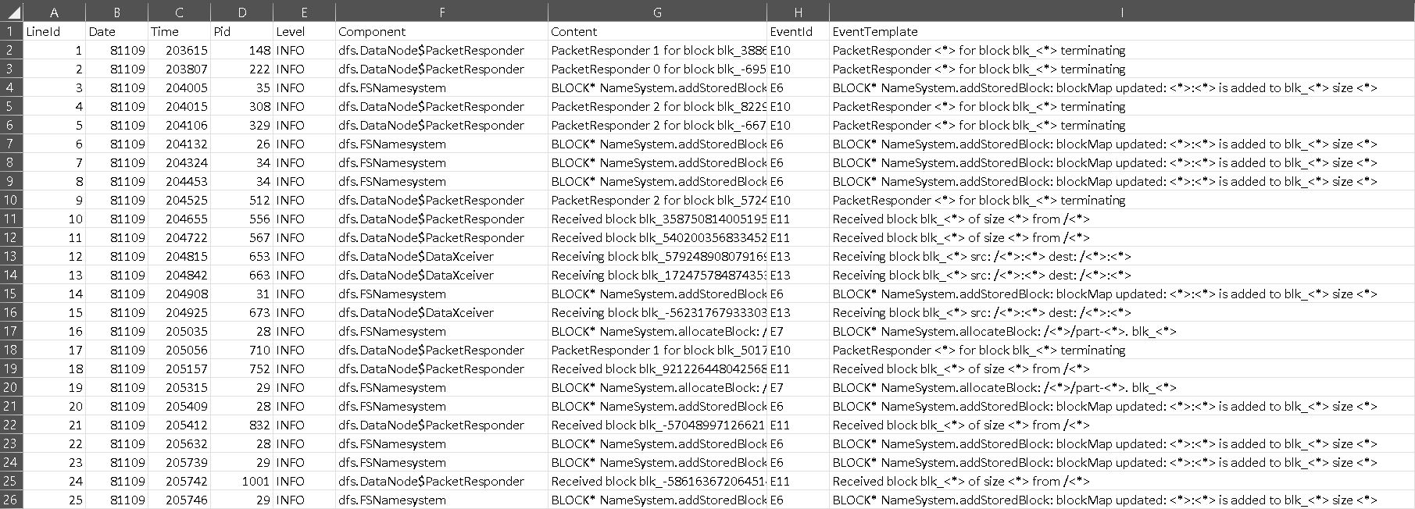
Data Description

Slide 8

Data Description
• Type of data: System and Application Logs
• Nature of data: Semi-structured
• Key Fields:
– Timestamp
– Log Level (INFO, WARN, ERROR)
– Source
– Log Message

Slide 9

Hive analysis
Created external table from raw HDFS logs
Feature Variables and Target variable
    Target Variable:-
      Incident
        Where 0 is normal log
        Where 1 is for error/warning
    Feature variables:-
      Component
      Time_Window
      Warn_Count
      Unique_Event_Count
      Log_Volume

Slide 10
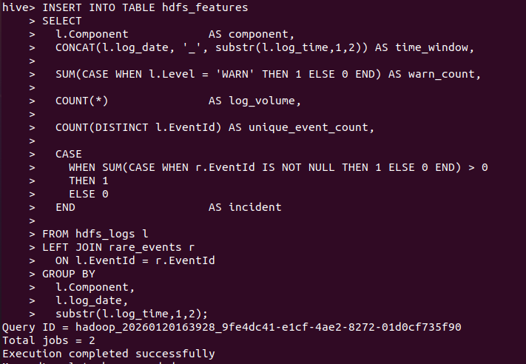

Data processing

Slide 11
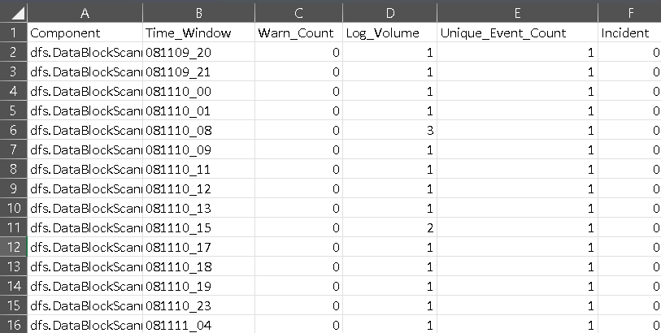
HDFS_FEATUREs.csv

Slide 12
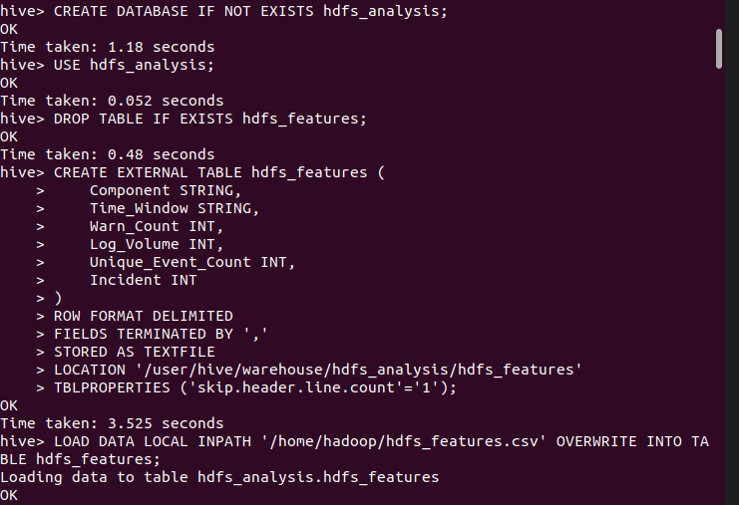
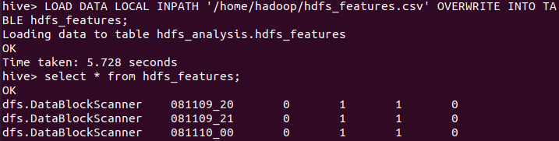
Comprehensive HQL analysis scripts for HIVE:

Slide 13
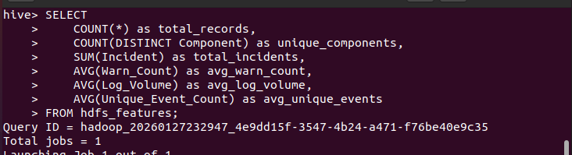
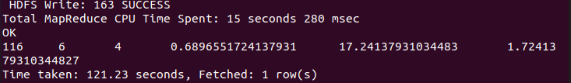
1.Basic statistics and aggregations

Slide 14
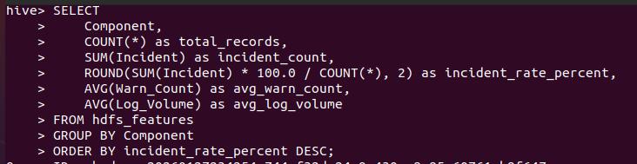
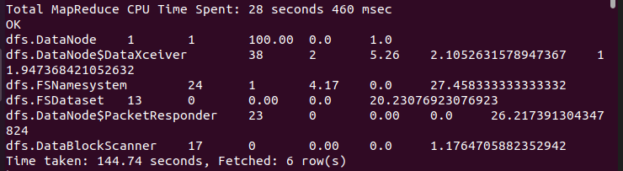
2. Component-wise Incident Rate Analysis

Slide 15
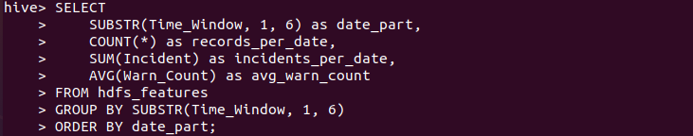
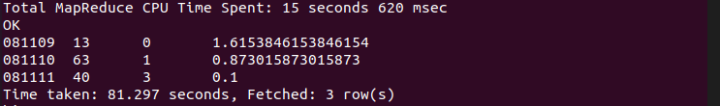
3.Time Window Analysis

Slide 16
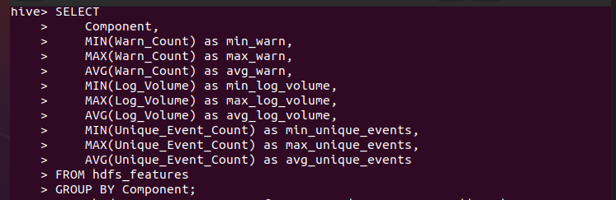
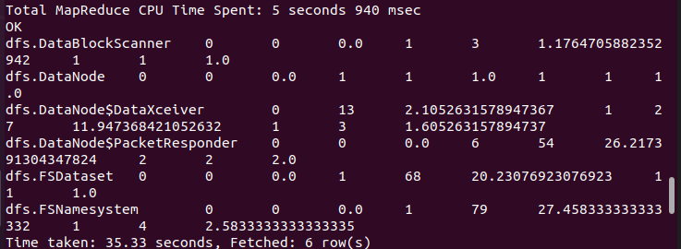
4.Component-wise Feature Analysis

Slide 17
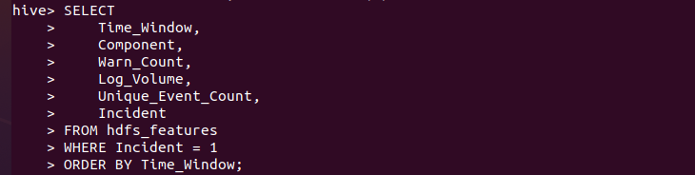
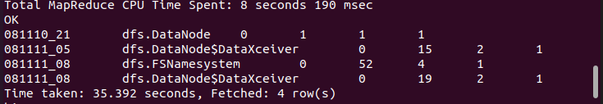
5.High Risk Time Windows (where incidents occurred)

Slide 18
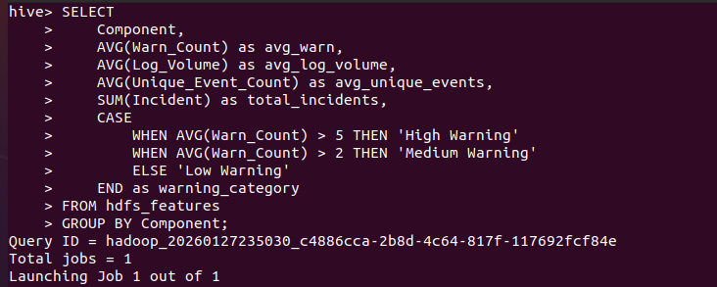
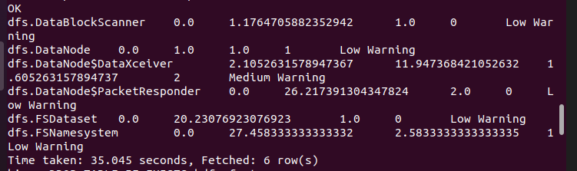
6. Correlation Analysis (using window functions)

Slide 19
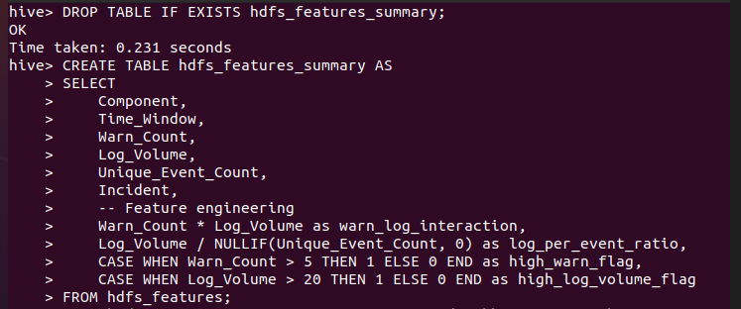
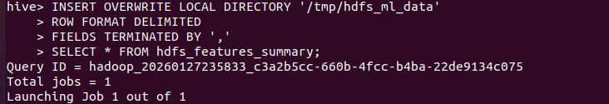
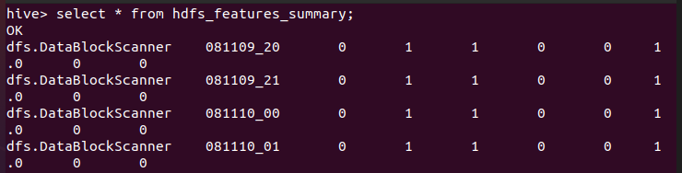
7. Export final summary table for ML features

Slide 20

PySPARk analysis
Exploratory Data Analysis (EDA) for HDFS Features Dataset
Comprehensive EDA with visualizations:
  Dataset overview and statistics
  Target variable analysis
  Component distribution analysis
  Feature distributions and correlations
  Time-based pattern analysis
  Incident vs features relationship analysis

Slide 21
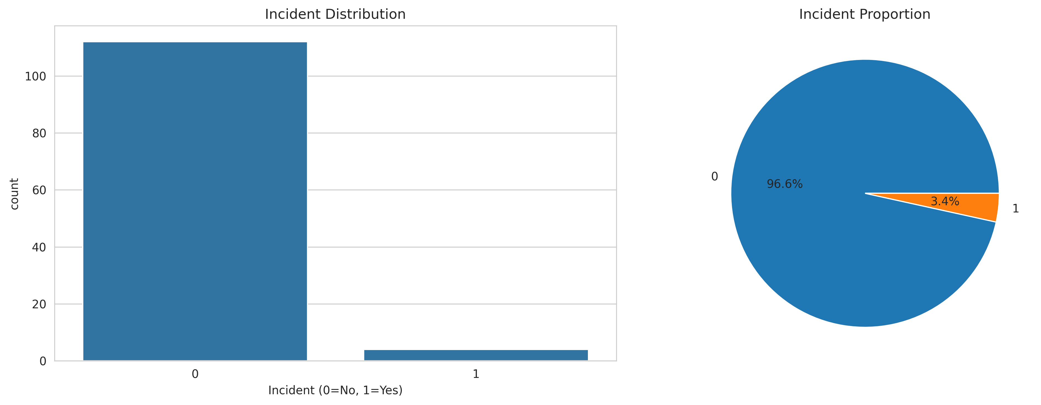
Comprehensive EDA with visualizations
1. Dataset overview and statistics

Slide 22
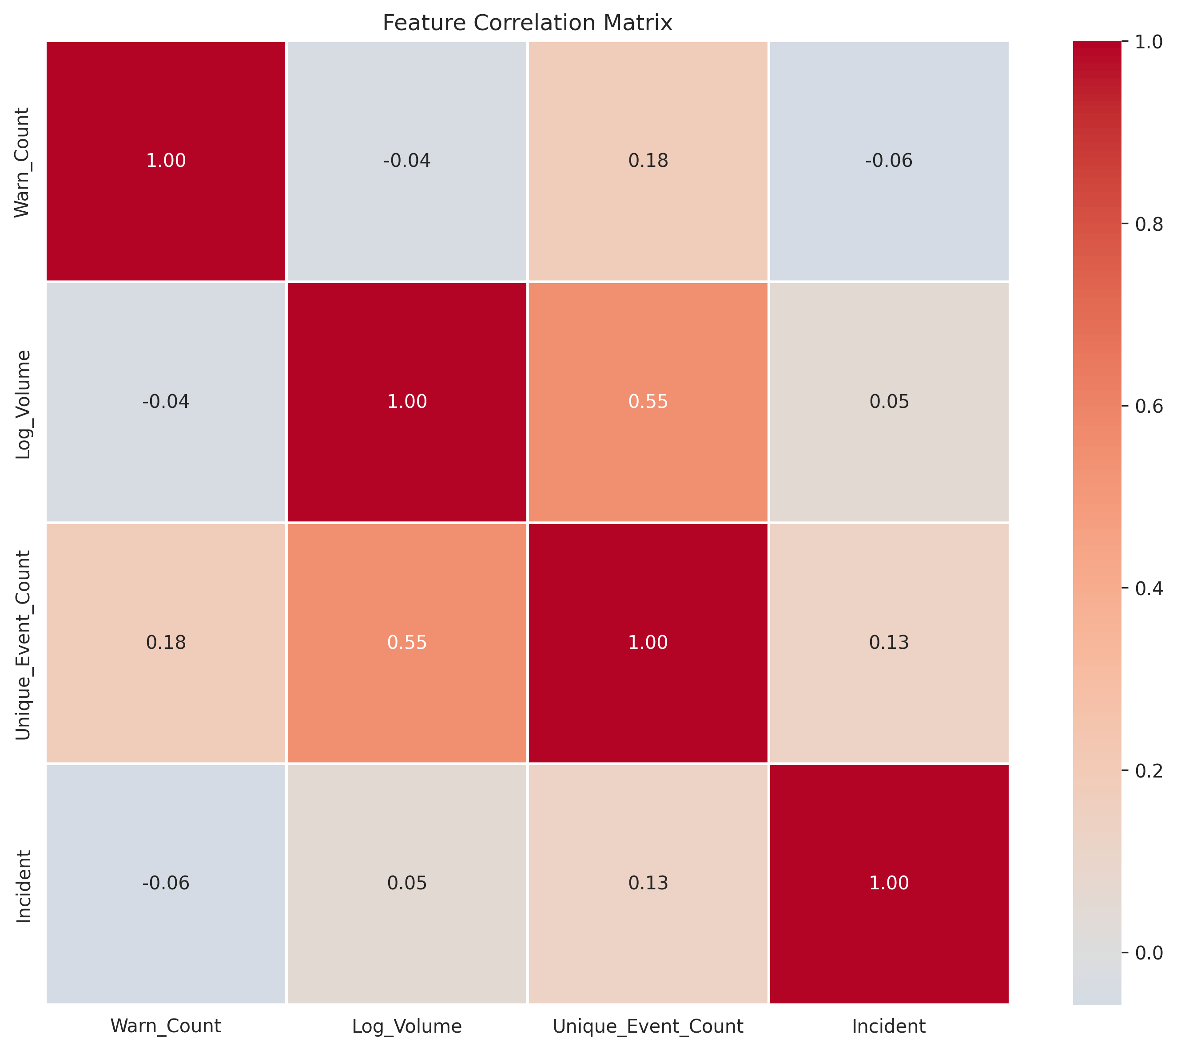
2. Target variable analysis

Slide 23
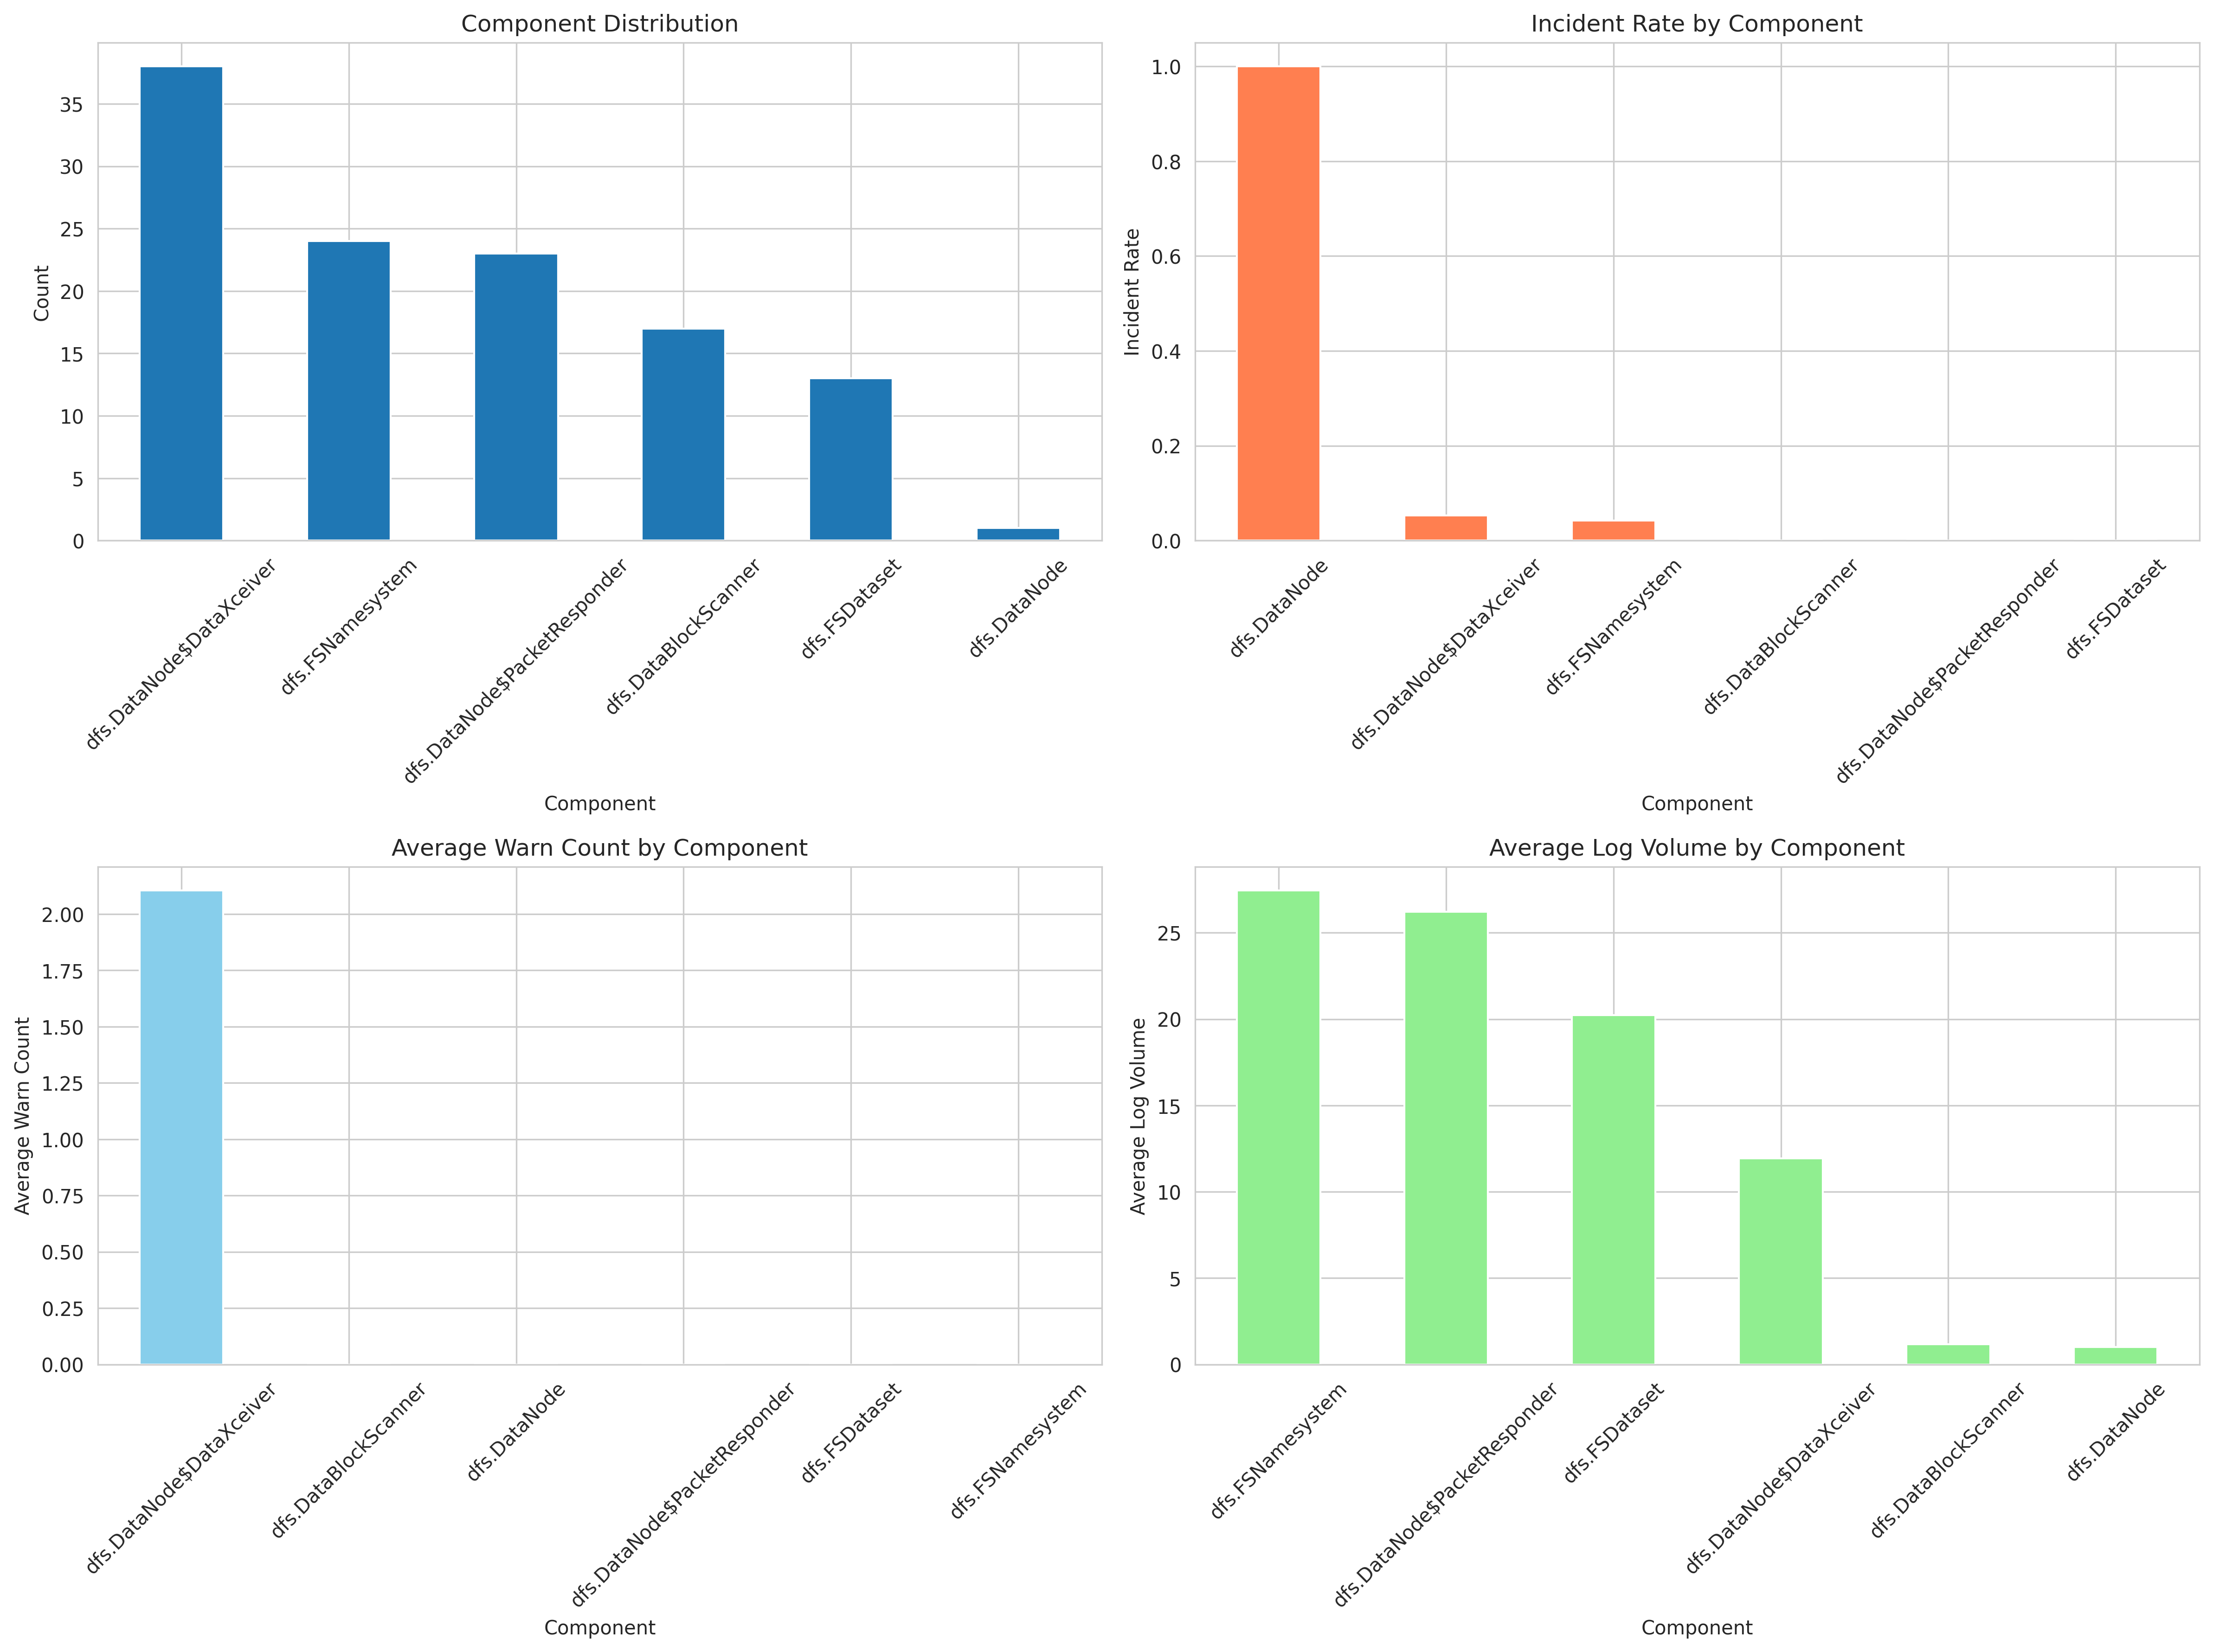
3. Component distribution analysis

Slide 24
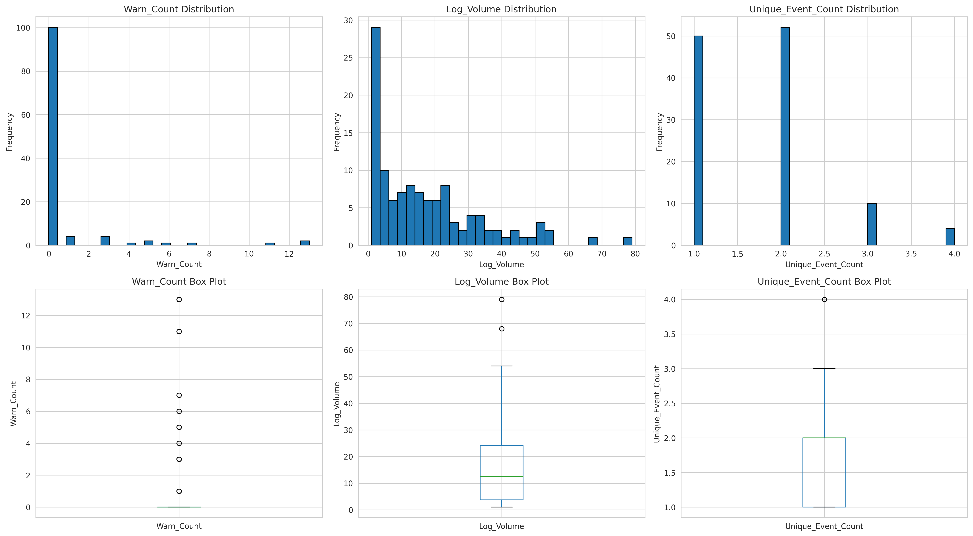
4. Feature distributions and correlations

Slide 25
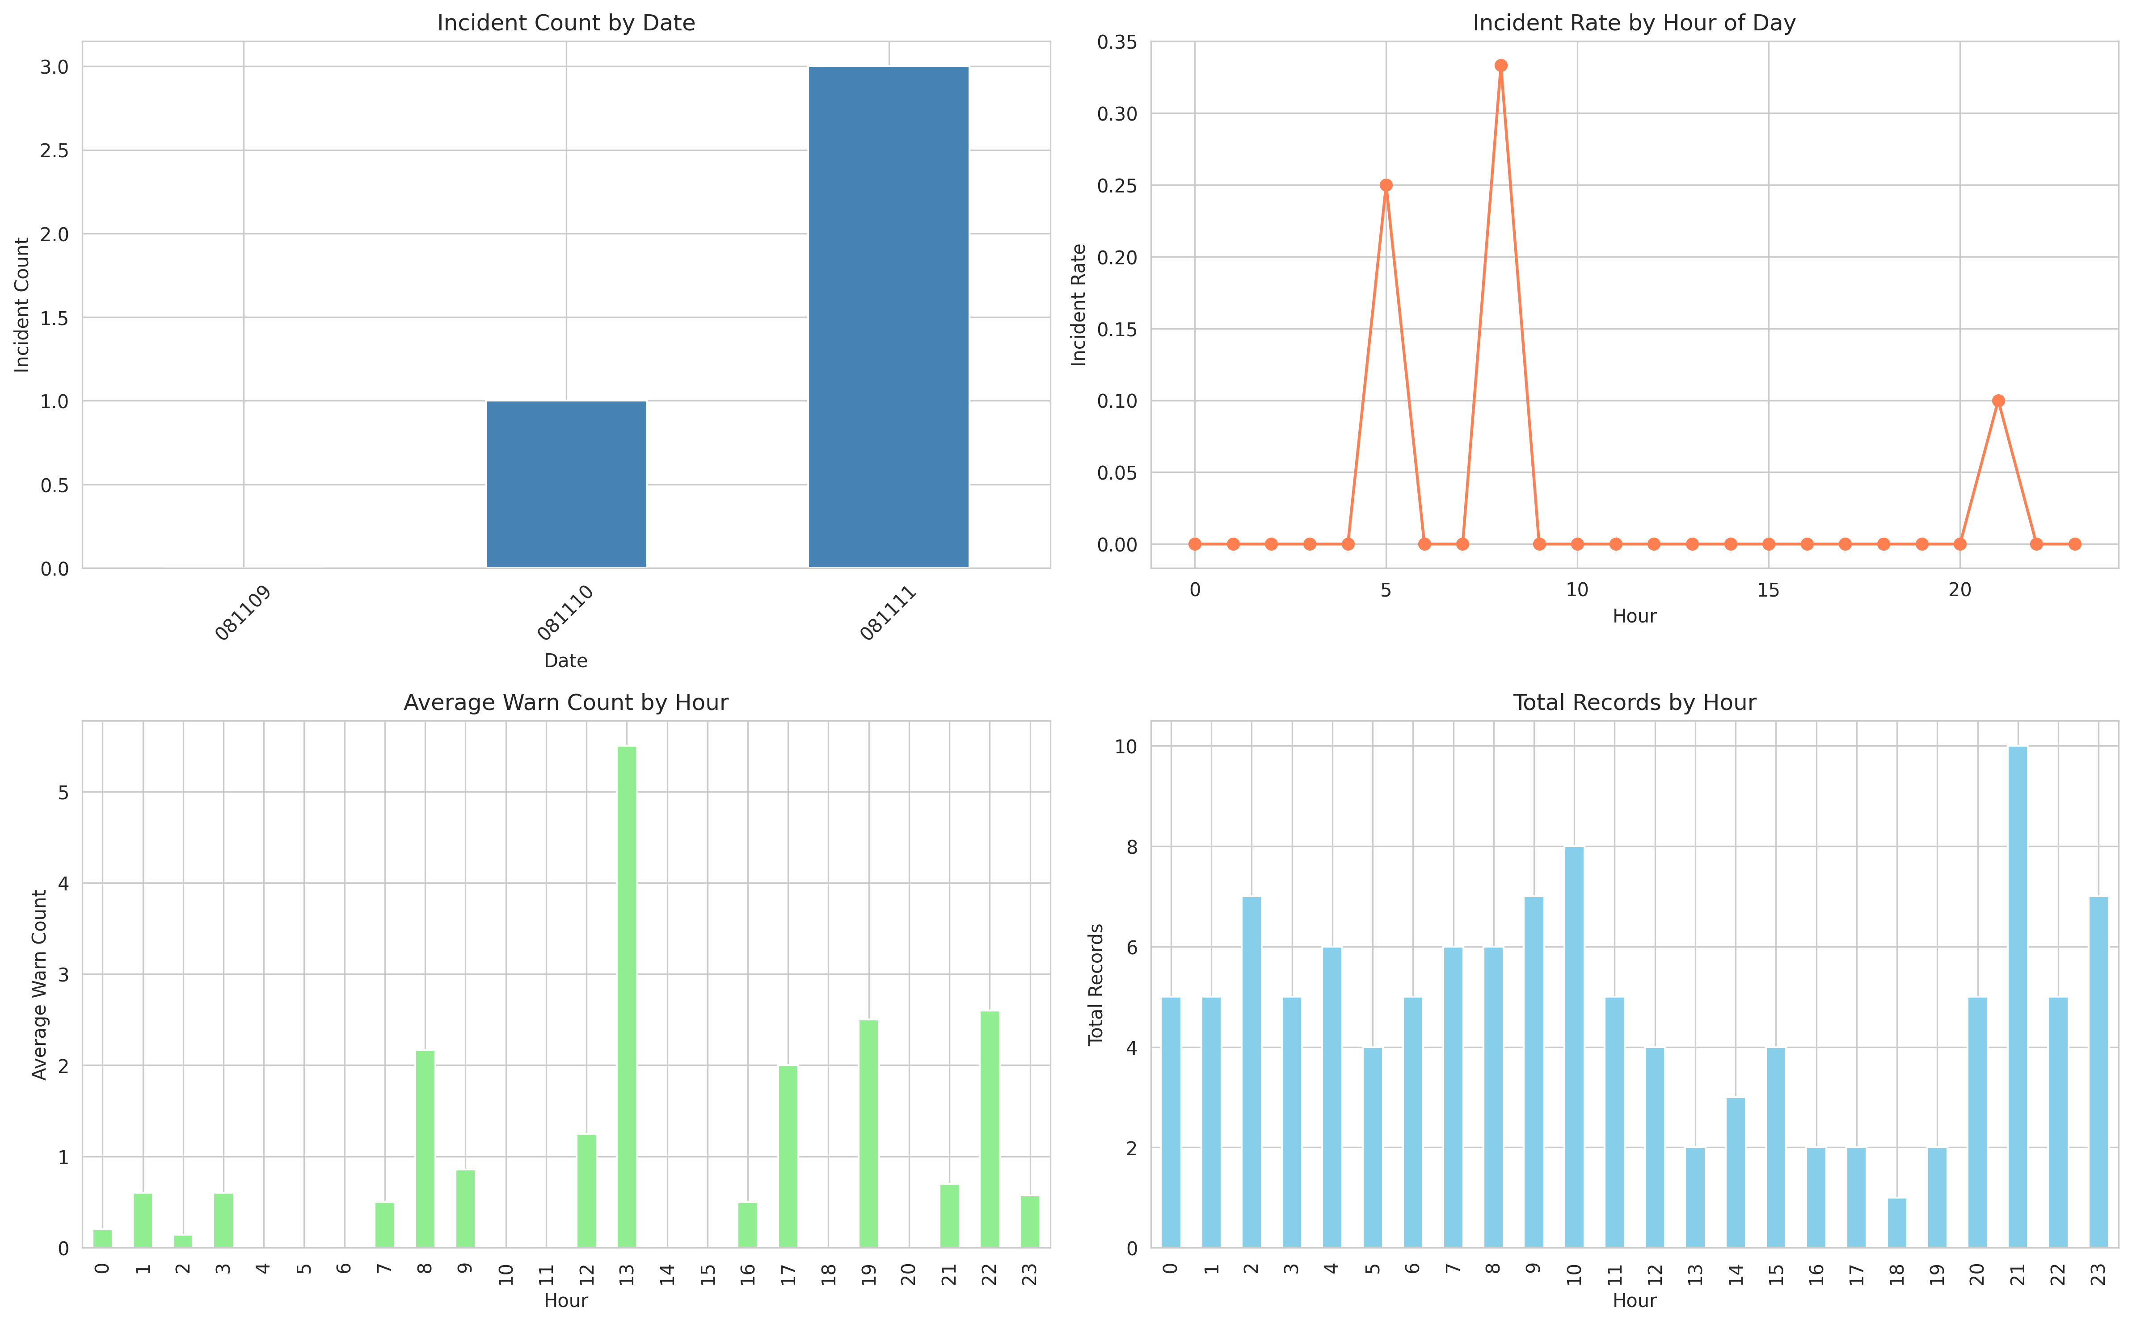
5. Time-based pattern analysis

Slide 26
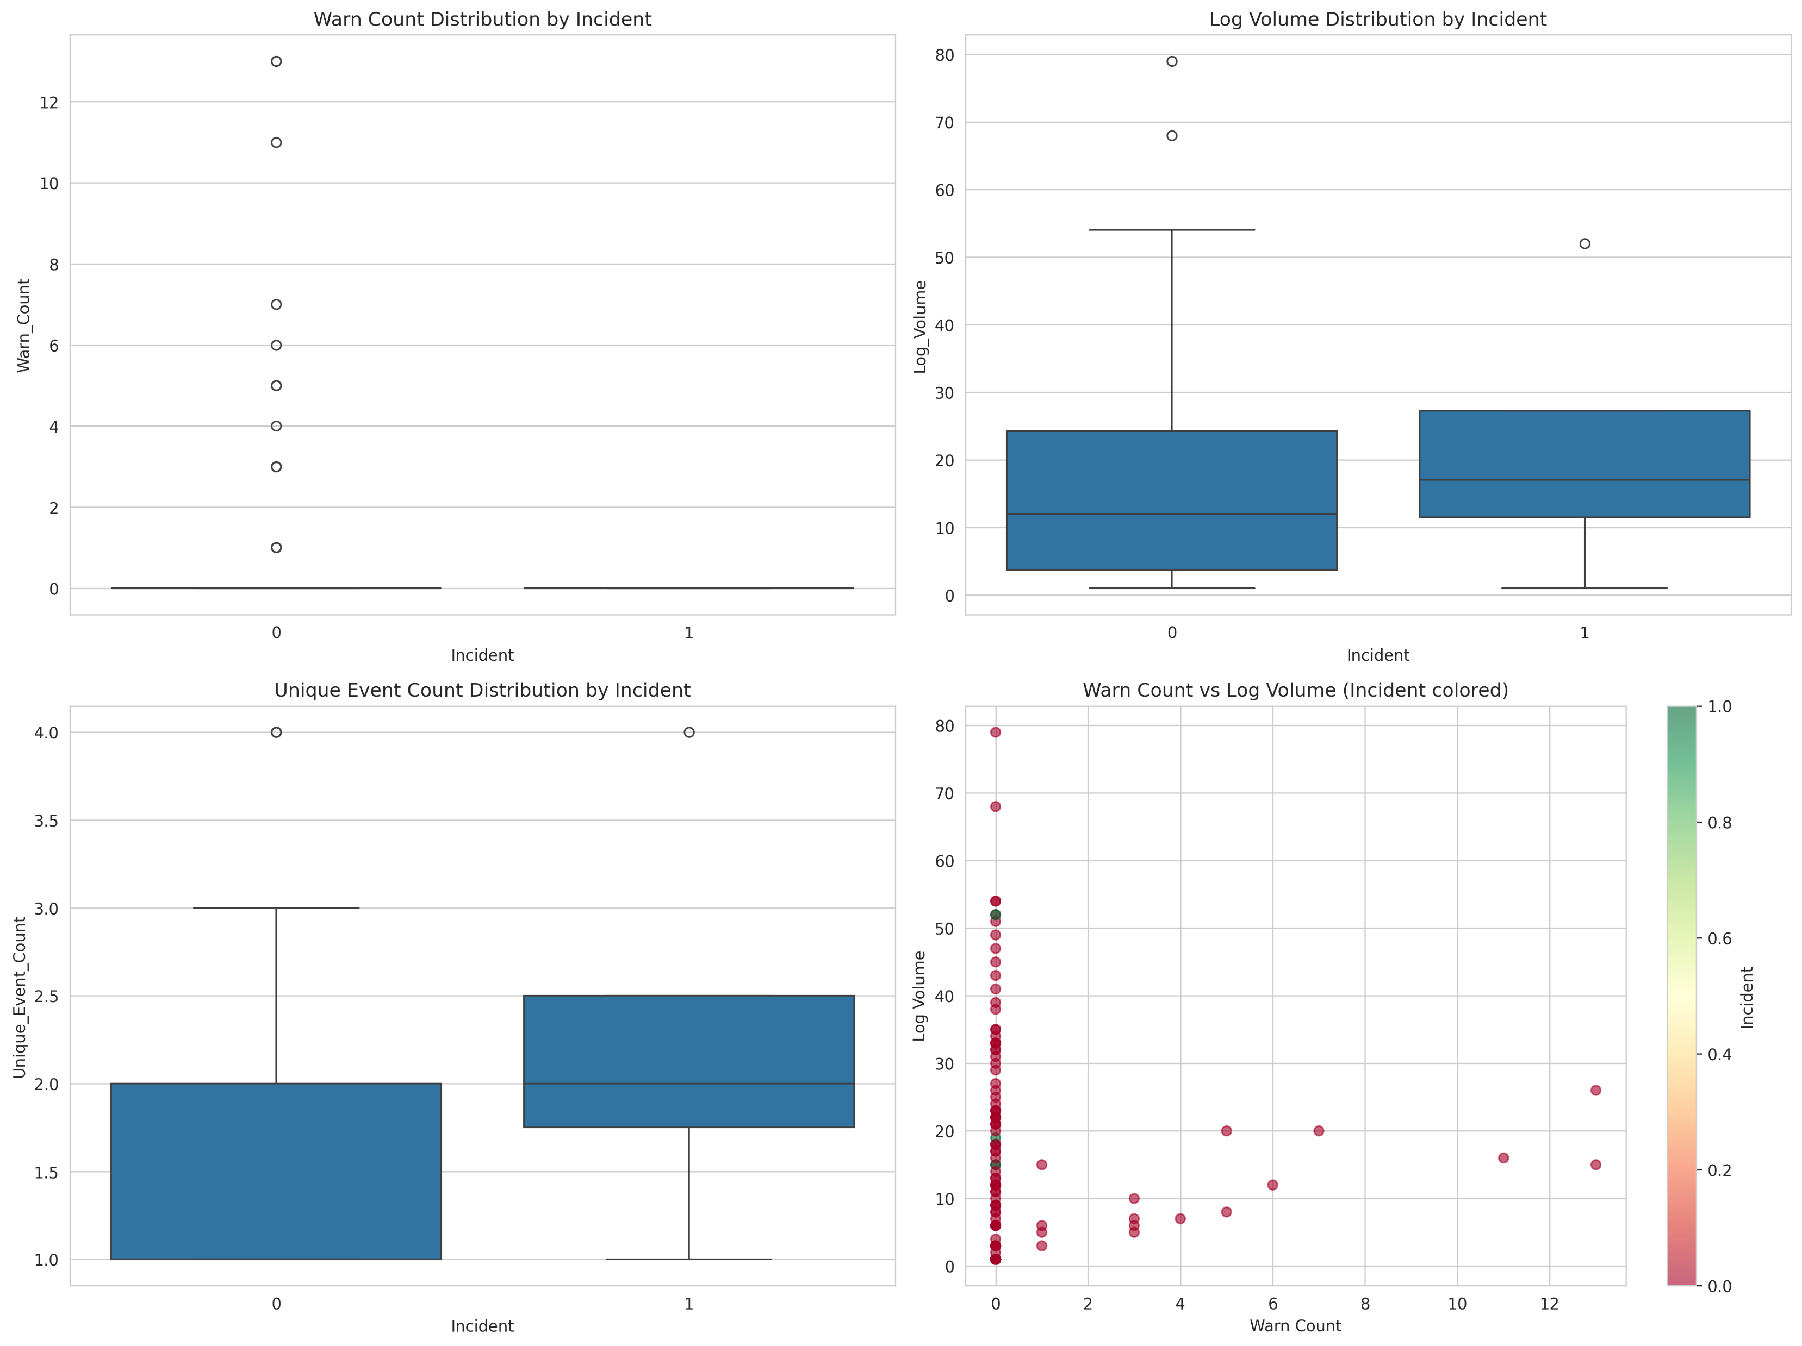
6. Target variable vs features variable relationship analysis

Slide 27
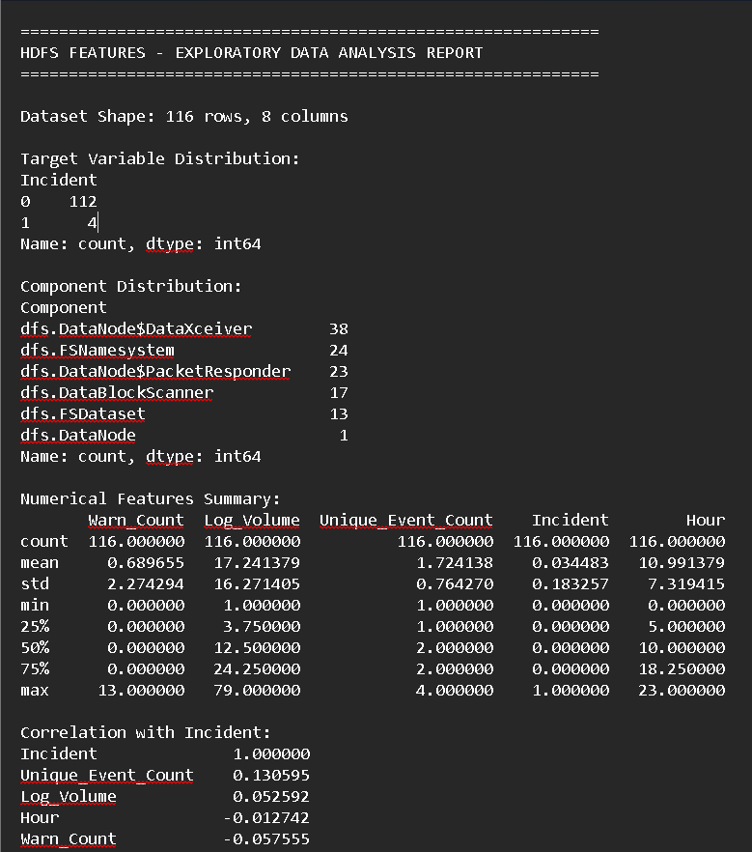
EDA Report

Slide 28

PySpark ML Model
Machine learning models using PySpark MLlib:
  Data preprocessing and feature engineering
  Multiple model options:
    Random Forest
    Gradient Boosting
  Model evaluation with comprehensive metrics
  Feature importance analysis
  Model persistence

Slide 29
Load CSV data into Spark DataFrame
Preprocess data for MLSplit dataset:- Missing values, Feature Selection
Create feature engineering pipeline:- Index Component (categorical feature), One Hot Encoding, Assembling
Built ML models:
  Random Forest Classifier
  Gradient Boosting Classifier
Trained models on:
  warn_count
  log_volume
  unique_event_count
Predicted:
  incident
Model Evaluation:
  Accuracy, F1 score, Recall, Precision, AUC, and Confusion Matrix

Slide 30
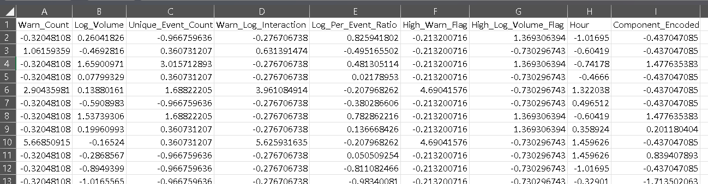
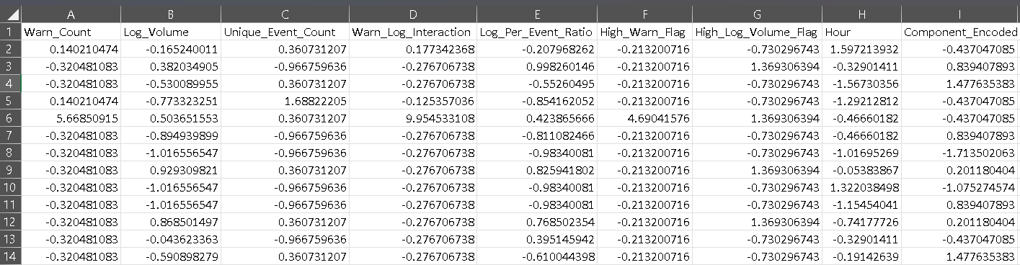
Train test split data
      Train Split Data
Test Split Data

Slide 31
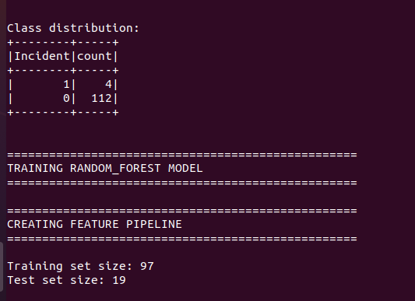
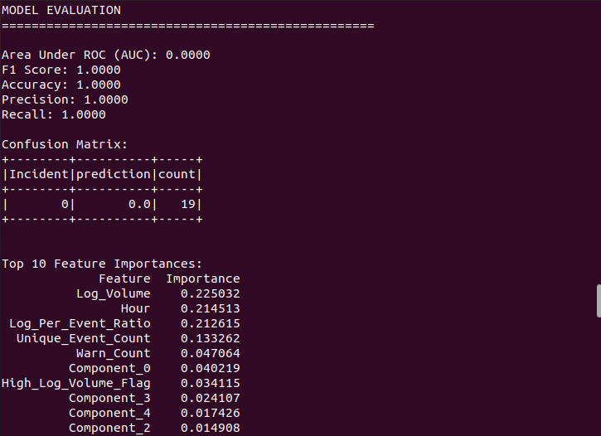
ML MODELS
1. Random Forest Classifier

Slide 32
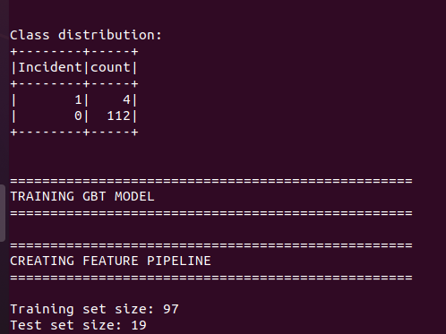
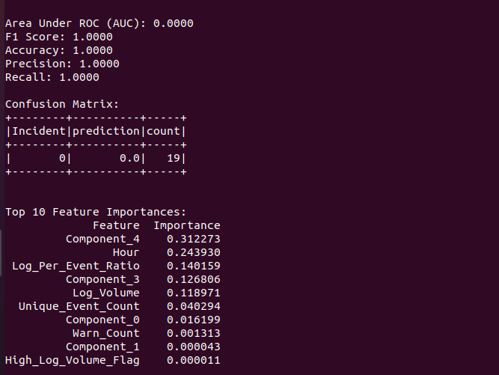
ML MOdels
2. Gradient Boosting Classifier

Slide 33

Apache Airflow Pipeline
End-to-end ML pipeline orchestration with scikit-learn:
  Automated data loading and validation
  Data preprocessing and feature engineering
  Model training with scikit-learn
  Model evaluation and validation
  Results persistence

Slide 34
Airflow DAG to automate entire pipeline
Pipeline Tasks:
1. `load_and_validate_data`: Load and validate CSV data
2. `preprocess_data`: Feature engineering and data splitting
3. `train_model`: Train scikit-learn model (Random Forest, Gradient Boosting Classifier)
4. `evaluate_model`: Generate evaluation metrics and reports
5. `model_validation_check`: Validate model meets performance thresholds
6. `save_results_summary`: Save pipeline summary
Pipeline Flow
HIVE TASK
PYSPARK TASK
SKLEARN TASK

Slide 35
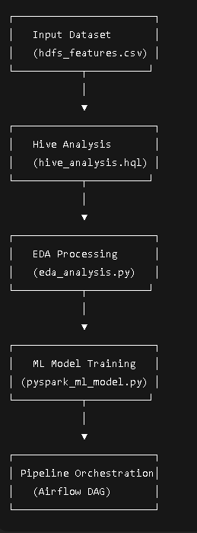

Slide 36
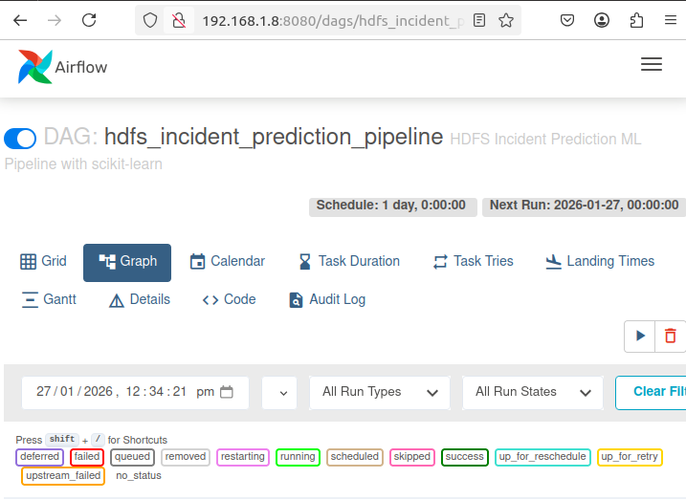
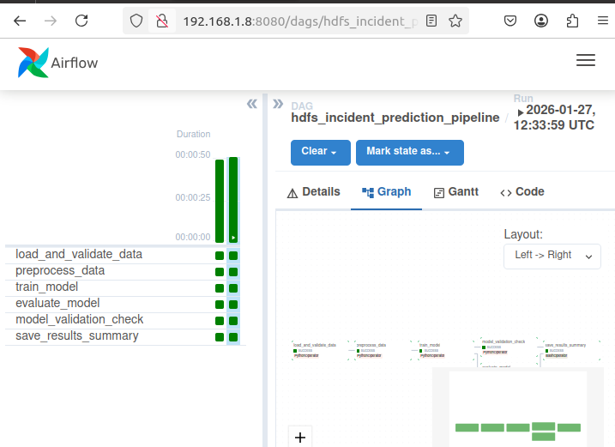
Triggering `hdfs_incident_prediction_pipeline` DAG

Slide 37
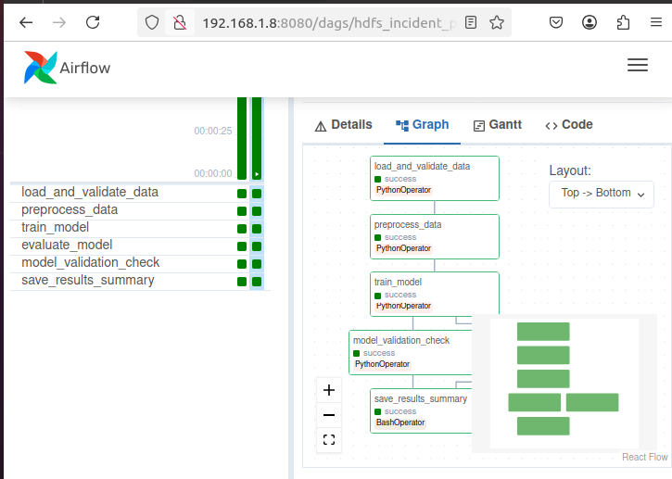
Airflow graph
Define task dependencies
task_load_data >> task_preprocess >> task_train >> [task_evaluate, task_validate] >> task_save_results

Slide 38

Results and Insights
• Achieved reliable incident prediction accuracy
• Identified critical log patterns
• Improved incident response efficiency
• Demonstrated scalability of the system

Slide 39
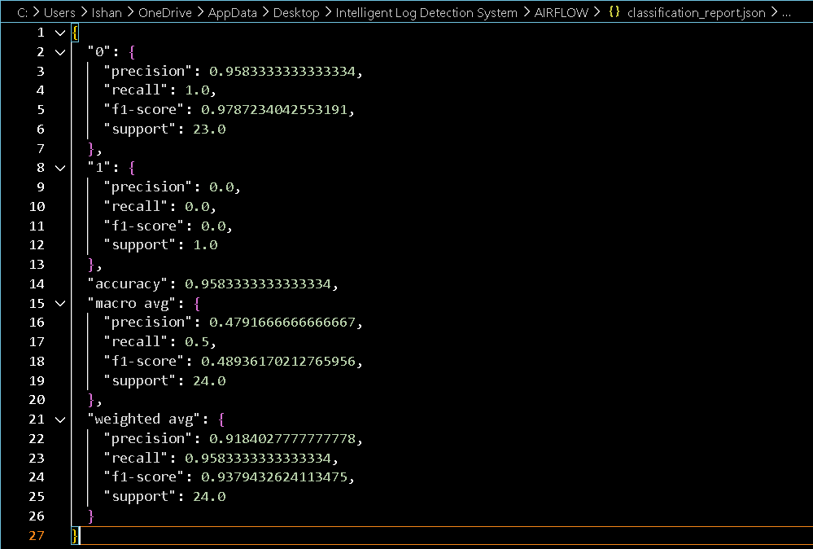
Classification report

Slide 40
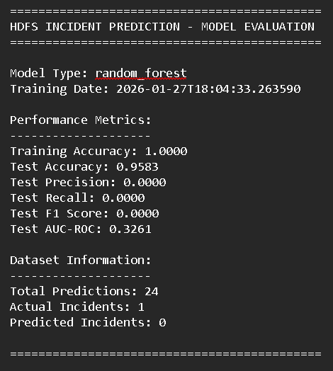
Evaluation Report

Slide 41
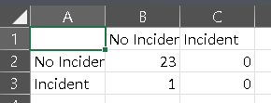
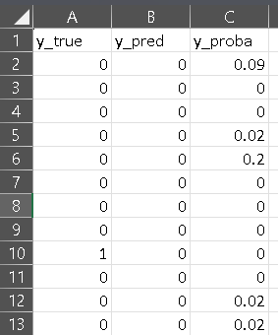
Confusion matrix and prediction
Confusion Matrix
Prediction

Slide 42

Conclusion
• End-to-end automated log analytics system
• Scalable big data processing architecture
• Proactive incident prediction using ML
• Suitable for real-world enterprise environments

Slide 43


